Slide 1
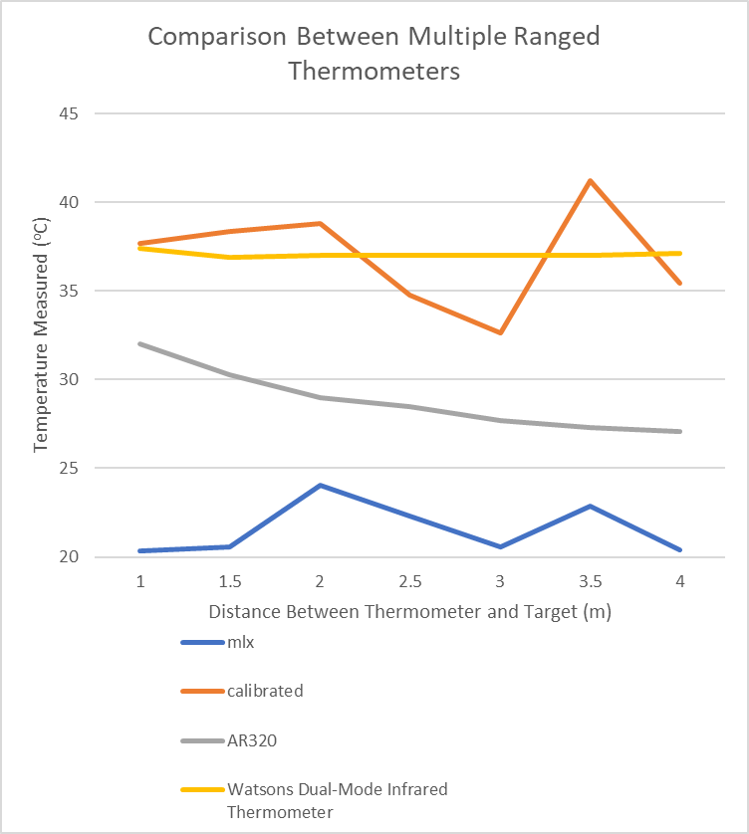
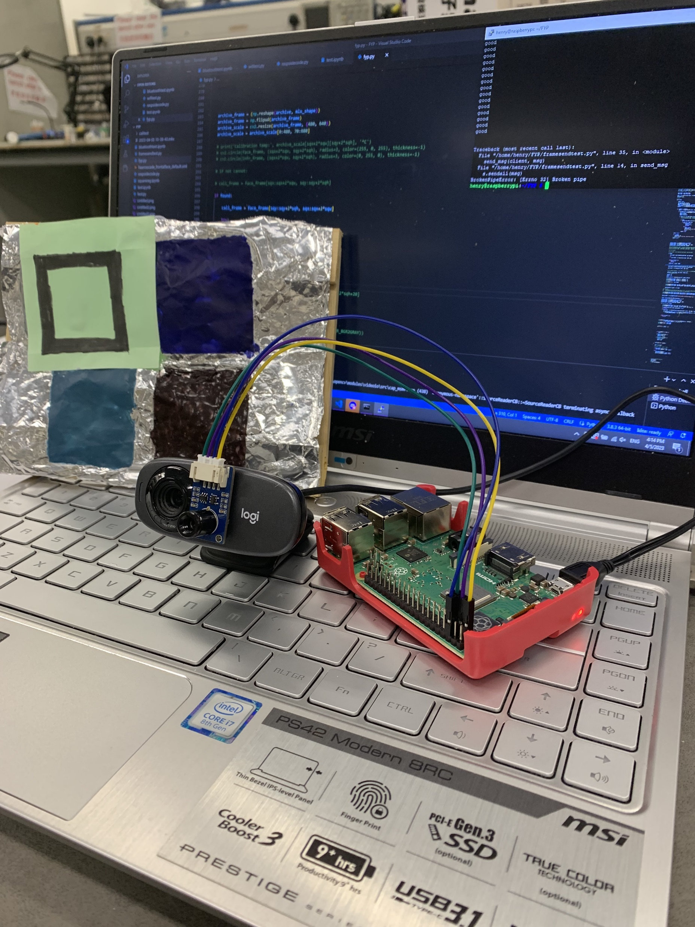
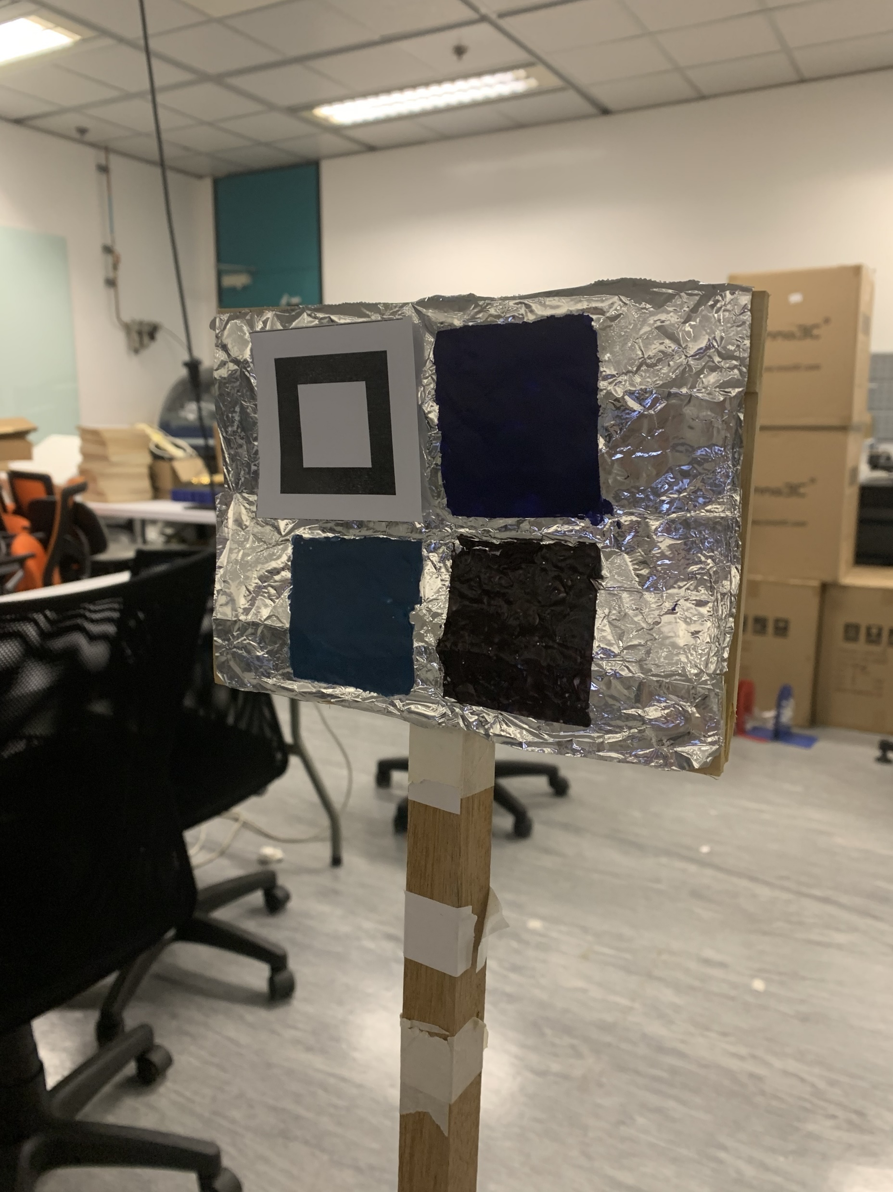
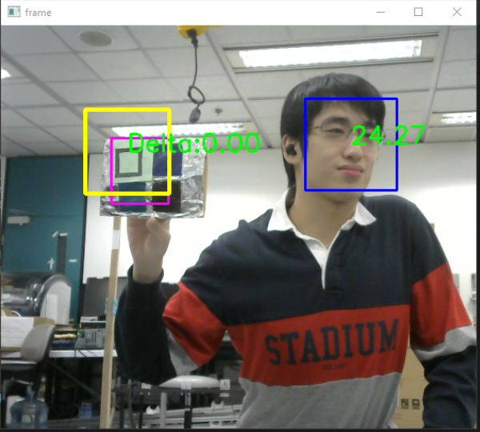
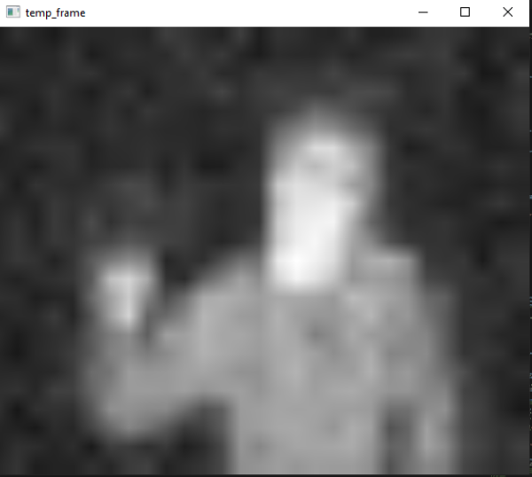
Heat-sensitive Paint for Thermal Camera Calibration (MWH02b-22) Li Hoi Him, Li Hong Yin, Lo Yat Hei Supervisor: Professor Mow Wai Ho
Introduction
Infrared thermal cameras are able to detect and capture thermal intensities emitted by different objects, similar to regular digital cameras creating images by capturing light reflected by regular objects. With this function, thermal cameras can detect body heat of human beings, which is especially useful during the pandemic, when we have to isolate the sick from the healthy by telling if a person is having a fever or not. However, thermal cameras can measure the exact temperature of the object it is facing only with the help of a calibrator that relates thermal data from a specific heat source to the camera. Therefore, how to design a powerful calibrator has become a hot topic for researchers in the past few years.
Objective
We propose a new calibration system that uses low-cost heat sensitive paint (HSP) to minimize cost and enhance efficiency. With the property of colour-changing in accordance to its temperature, it is possible to use a cheap heat source of variable temperature to relay its data in the form of optical signals to the thermal camera in real time from afar without using complex wireless communication systems.
Hardware Setup
There are three major components: the heat source, the heat sensitive paint indicator and the thermal camera which also serves as an RGB camera. The heat source does not have a constant temperature and is placed at a set distance from the camera. The palette of HSP is placed in physical contact with the heat source facing the camera to indicate the temperature.
Software Coding
Image processing is the key to identifying the optical signal sent by the calibrator. The software locates the HSP palette and identifies its colour. The program takes snapshots of the HSP frame by frame and records the uncalibrated temperature of the heat source the moment the HSP changes colour. This data is then used to calculate the correct temperature and applied to the person, who is located with facial recognition.
Results
After calibration, the thermal camera (mlx) produced much more accurate results, close to commercial infrared thermometers (AR320 and Watsons Dual-Mode Infrared, both taken at intended range instead of various distances), but effective at greater distances.
Future Work
Aside from measuring human body temperature and fever detection, the use heat sensitive paint for thermal camera calibration has other potential applications such as detecting inflammation symptoms in other parts of the body, and cooling systems of electronic appliances to detect overheating machinery.
Conclusion
Using heat sensitive paint, we have successfully created a calibration system which can improve the accuracy and effective range of thermal cameras for measuring human body temperature at a very low cost.
Problem | Research Gap | Proposed Solution
Thermal cameras cannot measure temperature accurately without a calibrator | Existing calibrators are complex, expensive and have limited range | Use Heat Sensitive Paint to display the temperature for calibration

